Slide 1
BOSCH RESEARCH
Perspective Images → 360° Panorama
Progress Update
From 7 ring-camera images to a complete-sphere ERP panorama (1024×2048)
QI PAN
I

Slide 2
DATASET
Dataset: Argoverse 2 Sensor
7
20 Hz
~300
RING CAMERAS · FULL 360°
CAPTURE RATE
FRAMES PER LOG
▸ 7 ring cameras give full 360° horizontal coverage · 20 Hz · ~300 frames per log.
▸ 3D box annotations + LiDAR + per-camera capture timestamps for every frame.
Waymo offers two sets, each missing half: Perception = 5 cameras ~250° forward (rear gap) with LiDAR + 3D boxes; End-to-End = 8 cameras full ring, but 10 Hz, 972-px, 1–2° overlap, rolling shutter, camera-only release. Only AV2 combines full ring + LiDAR + boxes + per-camera timestamps; Waymo migration stays queued as our generalization gate.
II

Slide 3
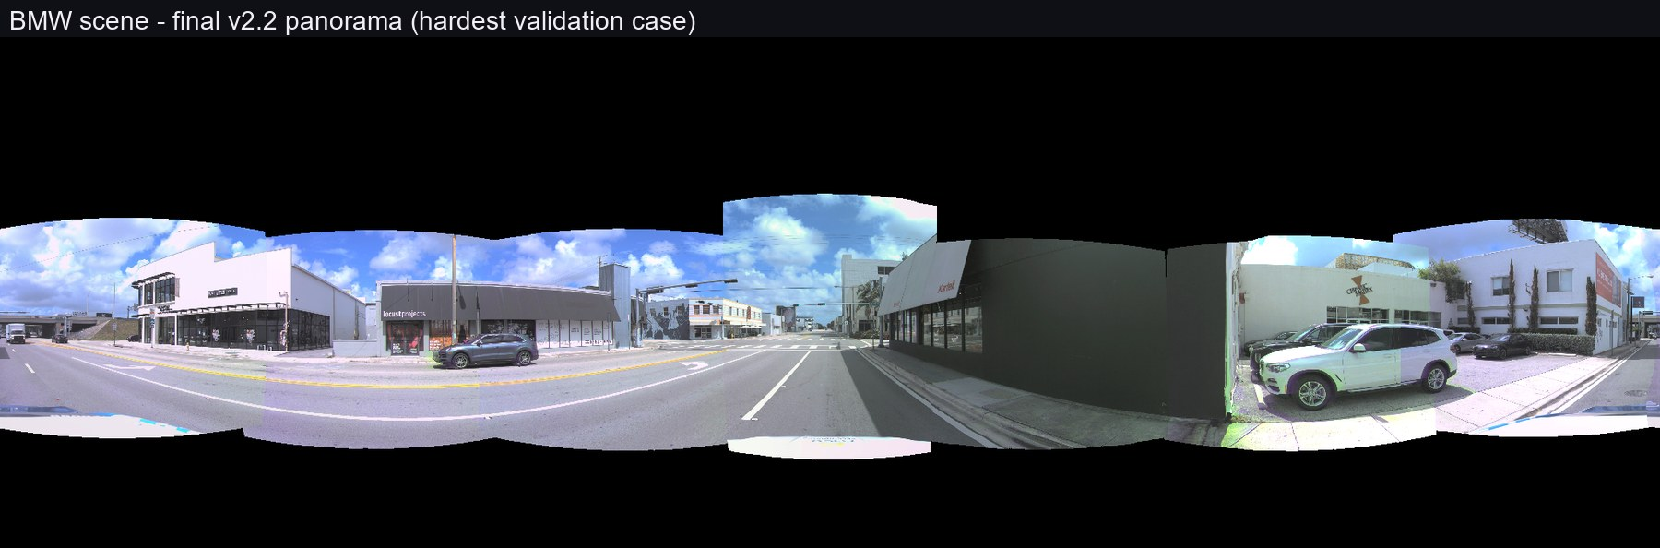
METHOD
Method: remove the cause — three fixes
① Virtual centre — project from the cameras' own centroid instead of the ego origin, using standard multi-view geometry (intrinsics/extrinsics ray casting) with per-pixel depth from accumulated LiDAR sweeps → projection residuals drop 18–96× and the seams come into alignment.
② EMC per-camera shutter poses —per-camera shutter poses — the seven cameras fire up to ±22.5 ms apart, so each image is projected with the ego pose of its own exposure instant, obtained by SE(3) pose interpolation (quaternion SLERP + linear translation) → the static world aligns exactly.
③ One body · one camera · one time (+OMC) — every moving object is rendered whole from a single camera at a single instant: YOLOv8 instance masks give the outline, the 3D boxes carry its identity across cameras (IoU association), the residual shutter shift is measured by ECC registration and compensated, and the patch is blended back through view morphing plus a minimum-error DP seam → ghosted / seam-cut cars impossible by construction.
IV

Slide 4
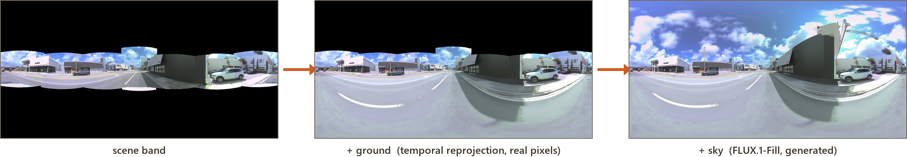
COMPLETING THE SPHERE
Outpainting the missing sphere: ground + sky
GROUND — real pixels, no generation
SKY — the only generated layer
INPUT scene-band panorama + the log's other frames (ego moved).
Method temporal reprojection — the road under the car now was photographed seconds earlier / later; reproject those real pixels (occlusion-checked).
OUTPUT nadir filled with 94.5–100% real pixels, lane lines continuous, ego hood removed.
INPUT panorama + sky mask (the only evidence-free region).
Method FLUX.1-Fill diffusion inpainting + DiT360 panorama LoRA, auto-prompt from the visible sky band (5/5 scenes correct).
OUTPUT complete sphere — every pixel outside the mask byte-identical to input.
V

Slide 5
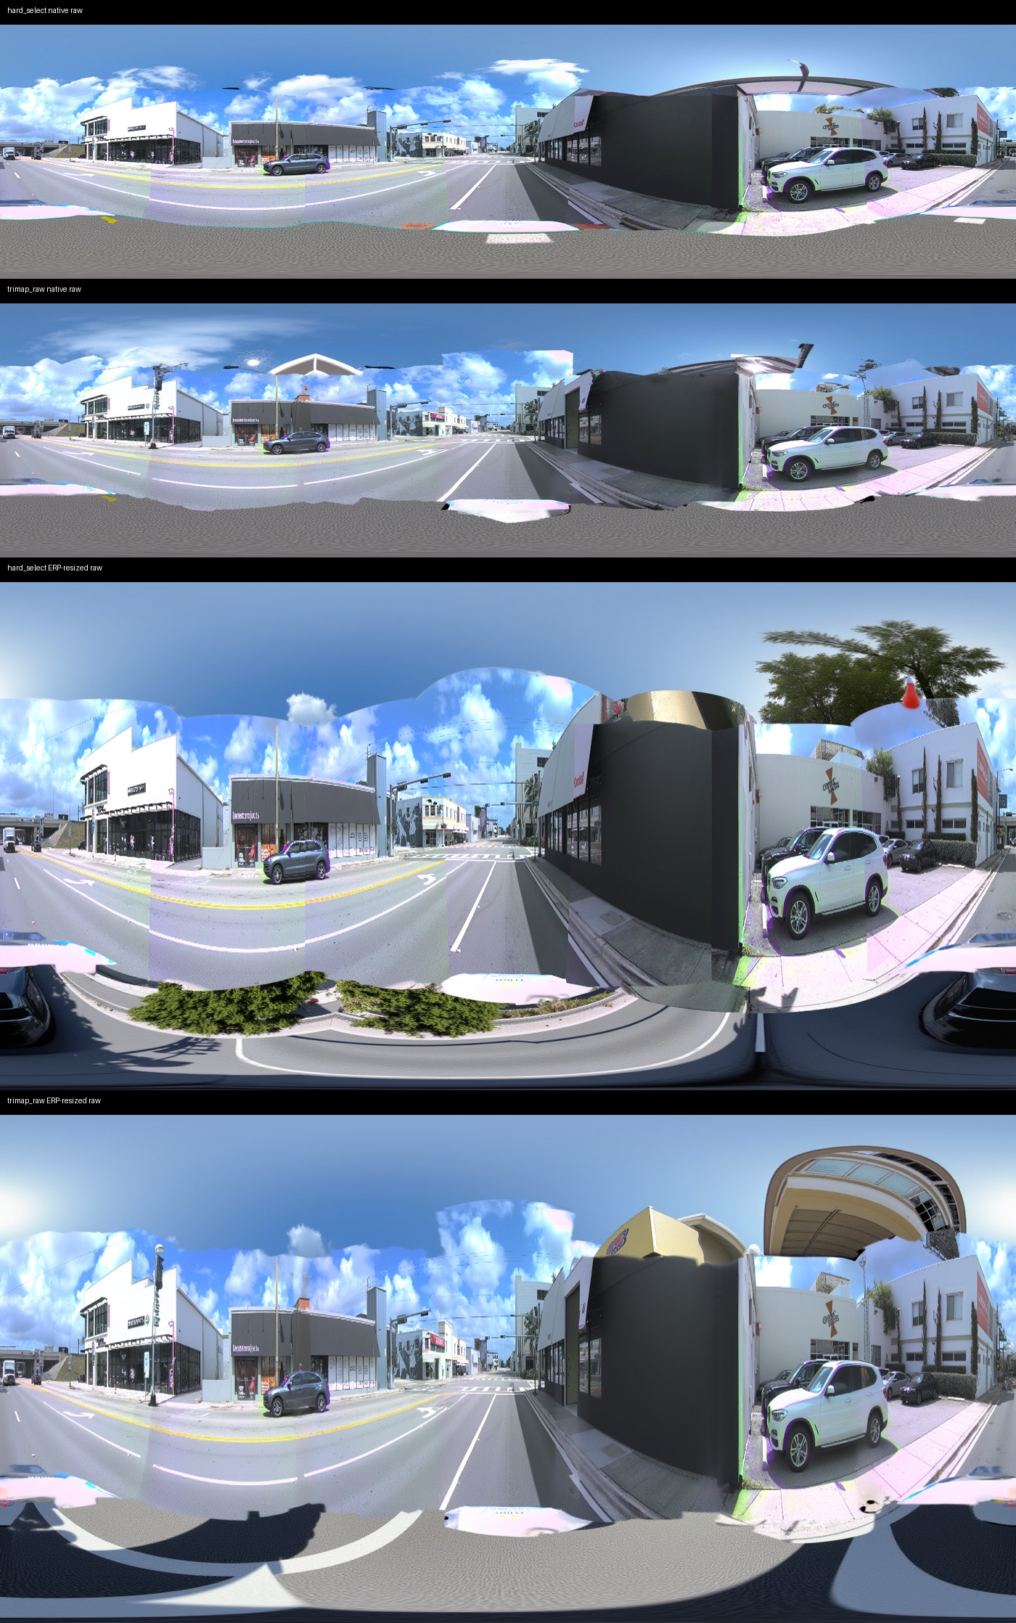

Slide 6
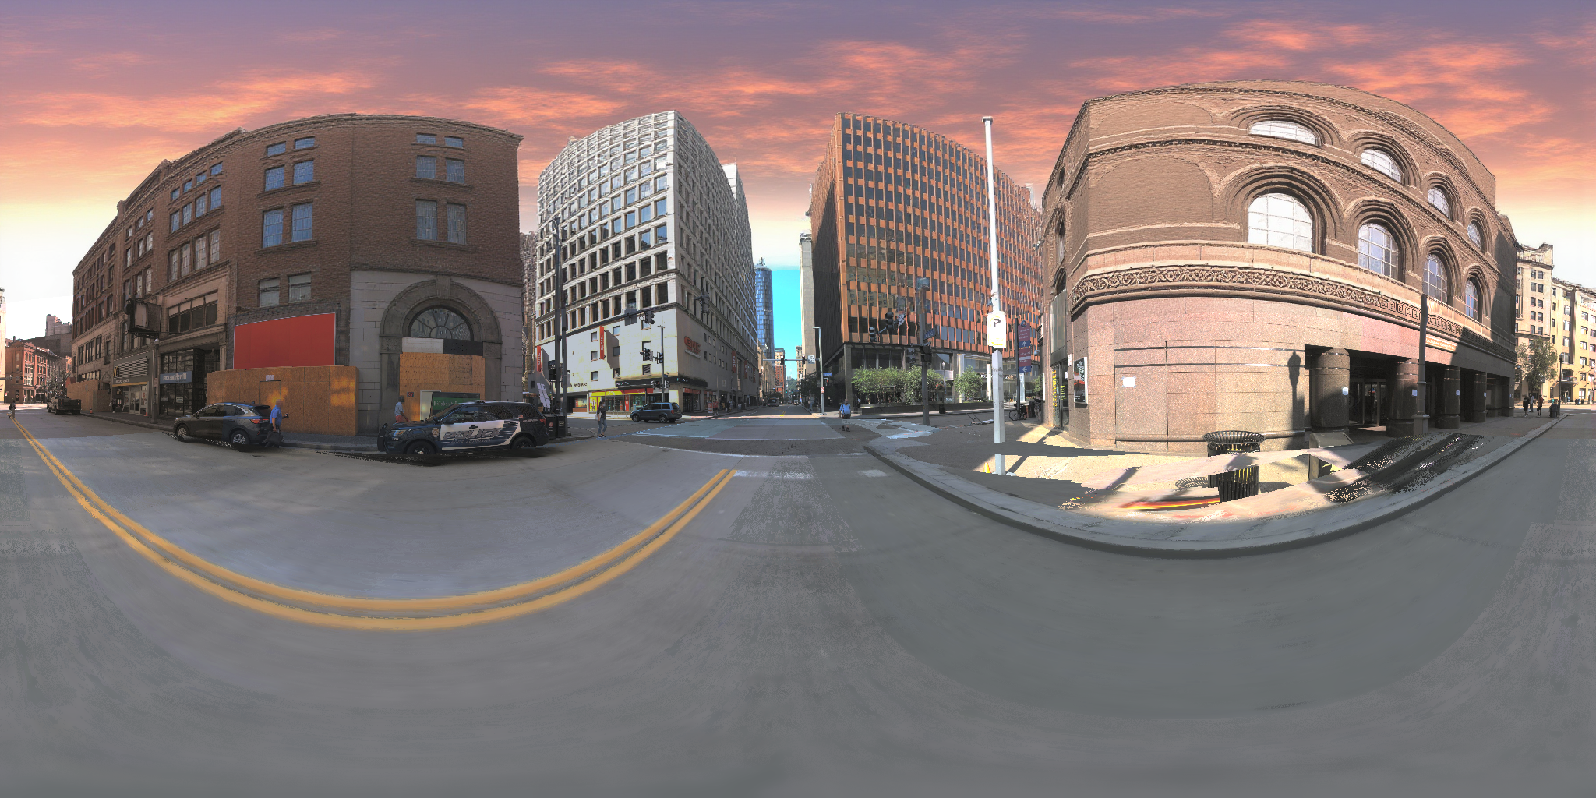
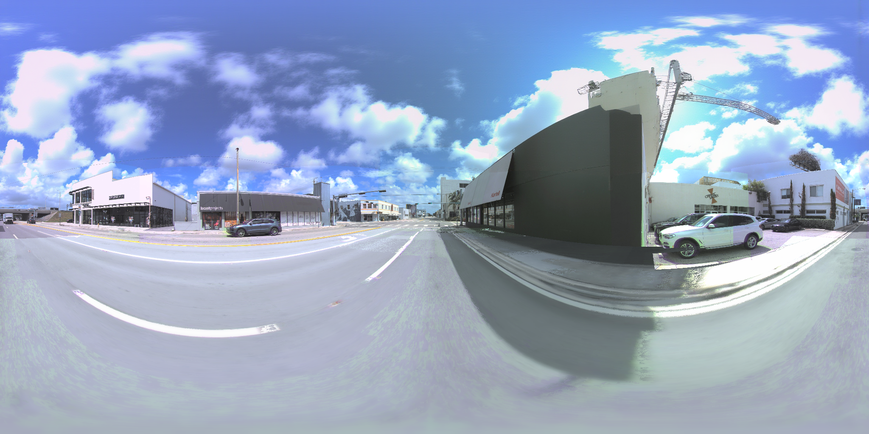
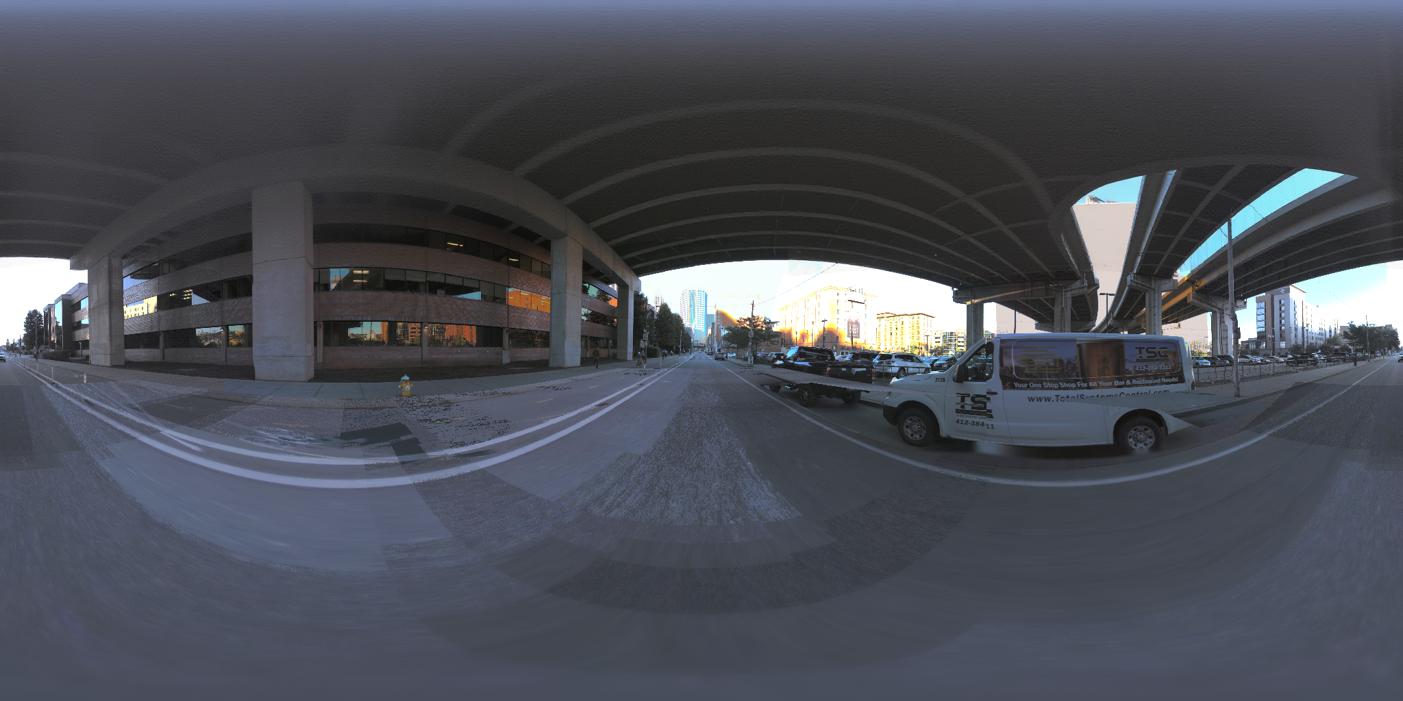
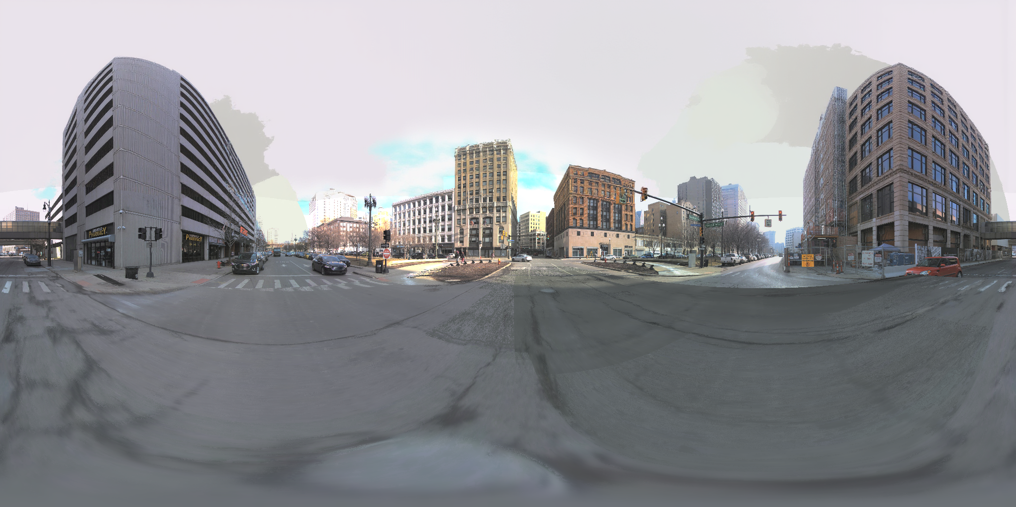
RESULTS
Current results: complete spheres
VI

